Slide 1

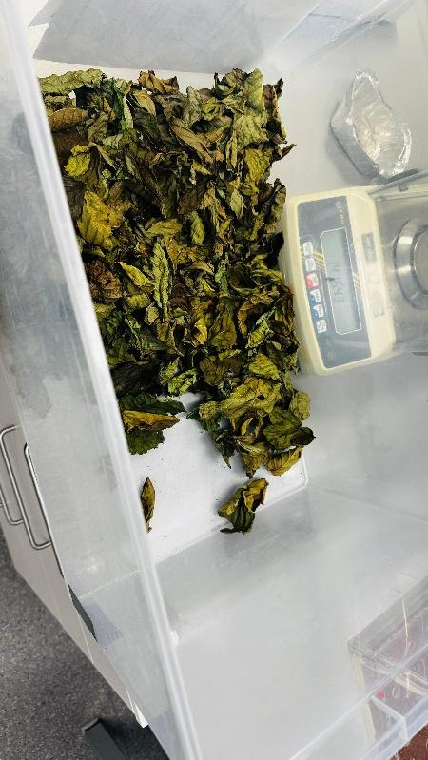
Leaf Decomposition
Across Multiple
Stressor Gradients
A Comparative Study of the Boye
and Kinzig Catchments, Germany
Ikenna Stephen Agube
M.Sc. Environmental Toxicology | University of Duisburg-Essen
Supervisor: Dr. V.C. Schreiner | SFB RESIST | April 2026

Slide 2

Presentation Outline
01
Introduction
Why leaf decomposition as a bioassessment tool
02
Study Area
Boye (urban-industrial) vs. Kinzig (agricultural)
03
Aims & Hypotheses
Research questions H1-H4
04
Methods
Field campaign, lab processing, statistics
05
Internship Results
Key findings from the Kinzig pilot study
06
Expected Results & Next Steps
Predictions and timeline

Slide 3

Why Leaf Decomposition?
Leaf Input
Microbial
Conditioning
Invertebrate
Shredding
DSM
Alnus glutinosa
Allochthonous
energy source
Hyphomycetes
Bacteria
Fine-mesh (500 µm)
Gammarus spp.
Trichoptera
Coarse-mesh (5 mm)
% AFDM lost
per degree-day
Functional metric
Key Principle
Decomposition rate is a functional indicator of stream ecosystem health that integrates the cumulative effects of multiple stressors on biological communities (Gessner & Chauvet, 2002).
Natural alder leaves respond to different environmental drivers than artificial substrates (Schreiner et al., 2023)
This study uses only Alnus glutinosa to measure actual ecosystem function

Slide 4


Multiple Stressors in Stream Ecosystems
Nutrients &
Agriculture
Trace Metals &
Industry
Physical Habitat
& Substrate
NO₃, PO₄ enrichment
Stimulates fungal growth
But degrades habitat
Cd, Cu, Fe, Ni, Pb, Zn
Suppresses hyphomycetes
Toxic unit approach
Fine sediment buries leaves
Coarse substrate → shredders
Flow → oxygen supply
Gulis & Suberkropp, 2003
Duarte et al., 2008
Lepori et al., 2005
Effects are often non-additive across stressor types (Crain et al., 2008)

Slide 5
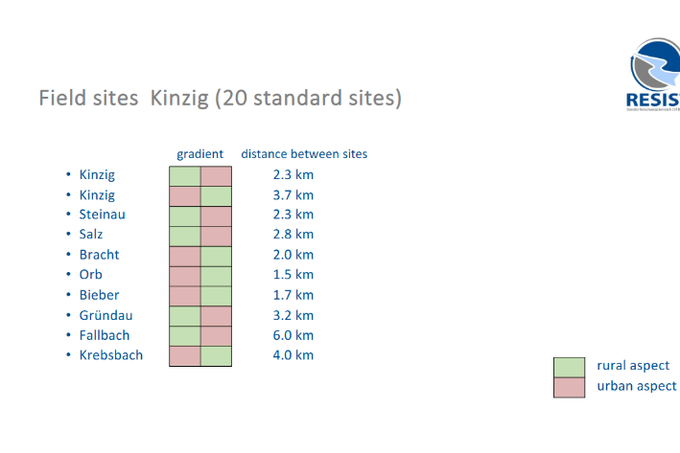
Study Area: Two Contrasting Catchments
March 2025 RESIST Field Campaign | 44 sites | 264 leaf bags
BOYE — 23 sites — Ruhr, NRW
KINZIG — 21 sites — Hesse
Urban-industrial stressor profile
Conductivity: 431–865 µS/cm
Elevated trace metals (Cd, Cu, Zn, Fe)
Fine substrate dominance (psammal)
Legacy coal mining & smelting
Agricultural LU: 2–93%
Agricultural stressor profile
Conductivity: 144–438 µS/cm
Low trace metals (10x lower than Boye)
Greater substrate heterogeneity
Rural-to-urban paired design
Agricultural LU: 14–71%
vs
Kinzig paired site layout (Agube, 2025)

Slide 6

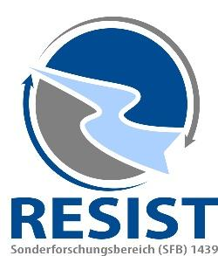
Research Aims
Which environmental variables most robustly explain variation in decomposition
across two contrasting German catchments?
1
Quantify microbial and total DSM across 23 Boye and 21 Kinzig sites
2
Identify the strongest physicochemical, substrate, land use, and biological predictors
3
Test metals → microbial suppression (Boye) vs. nutrients → stimulation (Kinzig)
4
Assess streambed substrate role in modulating decomposition pathways

Slide 7
Hypotheses
H1 General
Agricultural land use + conductivity negatively affect decomposition in both catchments
H2 Comparative
BOYE: Trace metal toxic units suppress microbial decomposition
(Duarte et al., 2008; Feyen et al., 2022)
KINZIG: Nutrient enrichment (NO₃ + PO₄) enhances microbial decomposition
(Gulis & Suberkropp, 2003)
H3 Fine substrate (Boye) suppresses total but enhances microbial DSM
H4 CPOM availability (Kinzig) enhances total DSM via shredder support

Slide 8
Field Design & Lab Processing
1
Leaf Preparation
3.5 g/bag | Fine (500 µm) + Coarse (5 mm)
2
Deployment
Boye: 4 Mar | Kinzig: 25 Mar | 6 bags/site
3
Retrieval
14–17 days | Cooled transport | Disk cutting
4
Lab Processing
60°C (48h) → 500°C (4h) → AFDM
5
DSM Calculation
Air-dried Alnus glutinosa
leaf stock material
% AFDM lost / (mean temp × days)
264 total bags | Transport controls for AFDM correction | Disk mass correction applied

Slide 9
Environmental Variables
Category | Variables | Method
Physico-chemical | pH, conductivity, DO, temperature, redox | MultiLine 3630 IDS
Nutrients | PO₄, NH₄, NO₂, NO₃, TN, Cl, SO₄ | Lab (water samples)
Trace metals | Cd, Cu, Fe, Ni, Pb, Zn + major ions | ICP-MS
Substrate | Makro, meso, mikro, psammal, CPOM, FPOM | Visual % cover
Land use | % agricultural, urban, industrial, rural | 2022 GIS
Invertebrates | 145 taxa (Boye); shredder %, Gammarus | Kick-net + bag sorting
Statistical Pipeline
Skewness
Screening
Collinearity
|r| > 0.70
VIF
Check
Stability
Selection
Linear
Models
LASSO on 50% subsamples | ≥70% selection freq. | PFER ≤ 1 | Separate models: microbial vs. total DSM

Slide 10
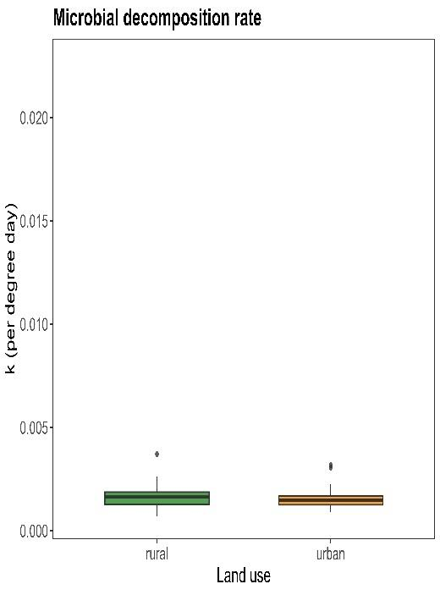
Internship Result: Microbial Decomposition
Kinzig catchment | 20 paired rural-urban sites | Summer 2025
Key Finding
No significant difference
p = 0.652
Microbial decomposition was similar across rural and urban sites.
Microbial communities appear functionally redundant or adapted, producing stable decomposition regardless of land use.
Figure 3 from Agube (2025)
Consistent with Gessner & Chauvet (2002); Schreiner et al. (2023)

Slide 11
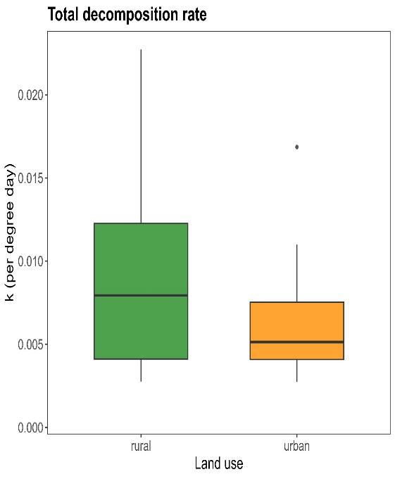
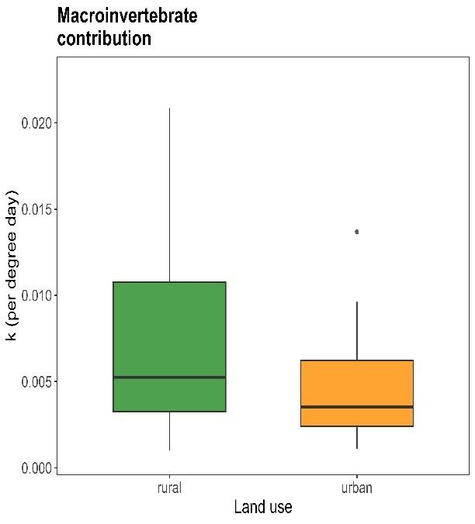
Internship Result: Total & Invertebrate Decomposition
Total decomposition (p = 0.078)
Macroinvertebrate contribution (p = 0.086)
Directionally consistent: Rural > Urban for total and invertebrate decomposition. Shredders comprised 87.5% of individuals in rural bags vs. 76.0% in urban.

Slide 12
Expected Results: Thesis Extension
Predicted Patterns
Boye
Metal toxic units suppress
microbial DSM; fine substrate
suppresses total DSM
Kinzig
Nutrients enhance microbial
DSM; CPOM enhances total
DSM via shredder support
Both
Agricultural LU + conductivity
negatively predict decomposition
across catchments
What the Thesis Adds Beyond the Internship
1
Boye catchment with trace metal data (urban-industrial comparison)
2
44 sites instead of 20; full environmental variable suite
3
Stability selection (LASSO) for robust predictor identification
4
Fungal barcoding data (pending) for community-level analysis

Slide 13

Summary & Next Steps
Internship showed stable microbial DSM but reduced invertebrate contribution in urban Kinzig sites
Thesis extends to 44 sites across two catchments with contrasting stressor profiles
Stability selection identifies robust drivers while controlling false positives
First comparative Boye-Kinzig decomposition dataset within the RESIST framework
Timeline to Defense
Apr–May 2026
May–Jun 2026
Jun–Jul 2026
Aug–Sep 2026
R pipeline
Stability selection
Results
Effect plots
Results chapter
Interpretation
Discussion
Literature
integration
Final revision
and defense
Thank you | Questions?

